Slide 1

saveOS
Adapt, improvise, overcome

Slide 2

saveOS

Slide 3
saveOS
Prevention
Mitigation
Preparedness

Slide 4
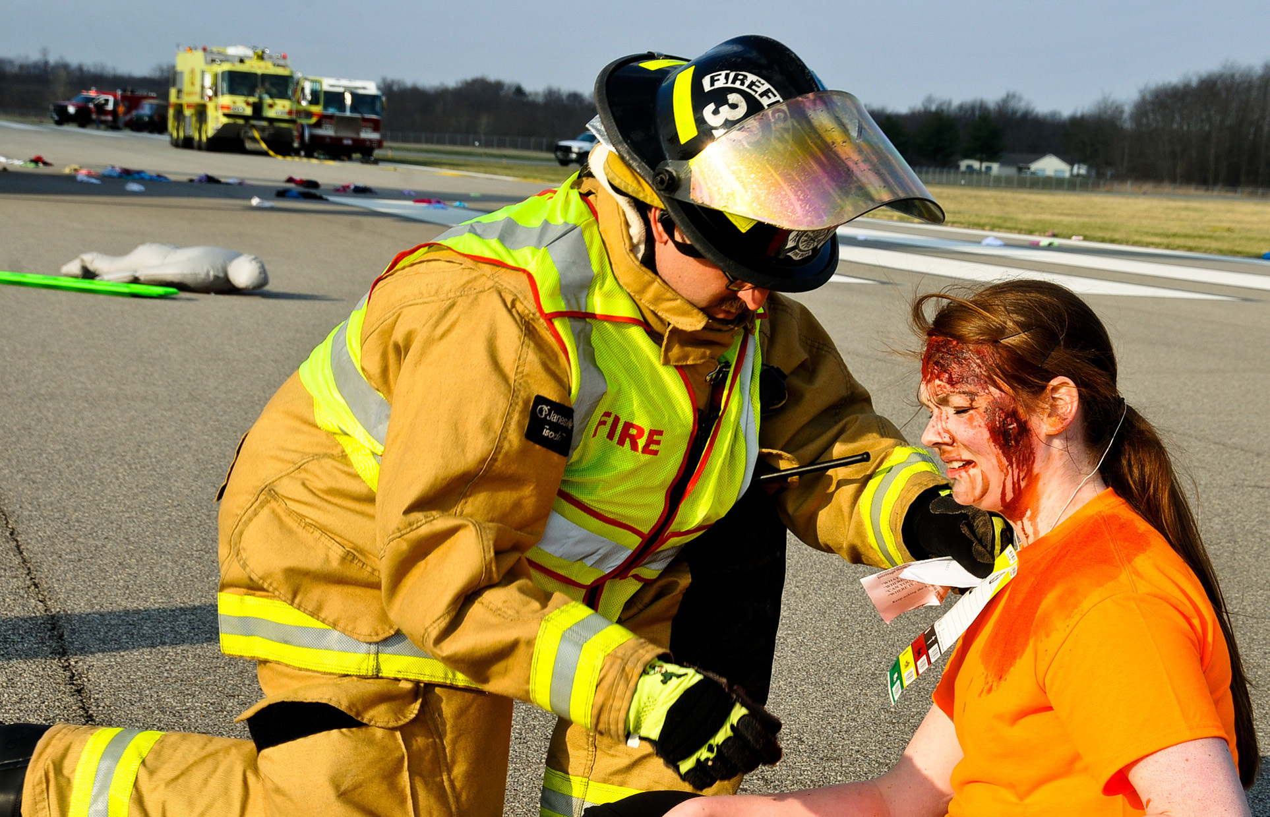
saveOS
Response

Slide 5
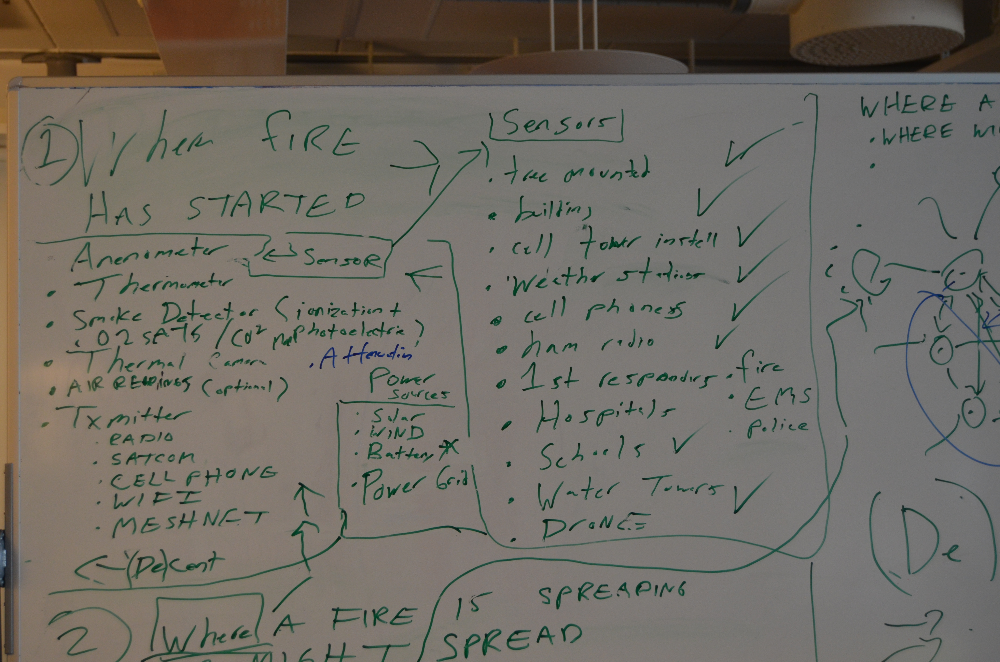
saveOS

Slide 6
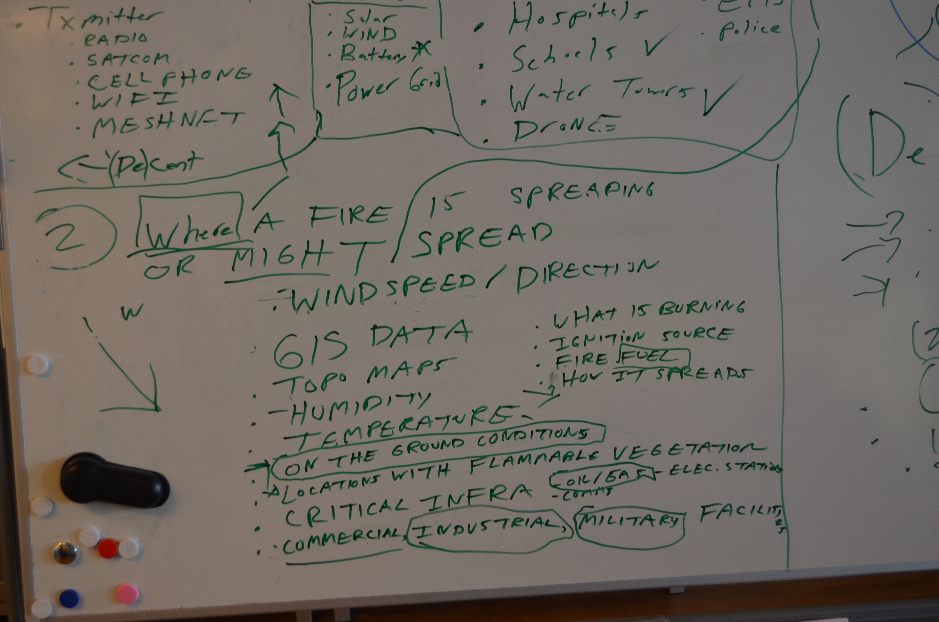
saveOS

Slide 7
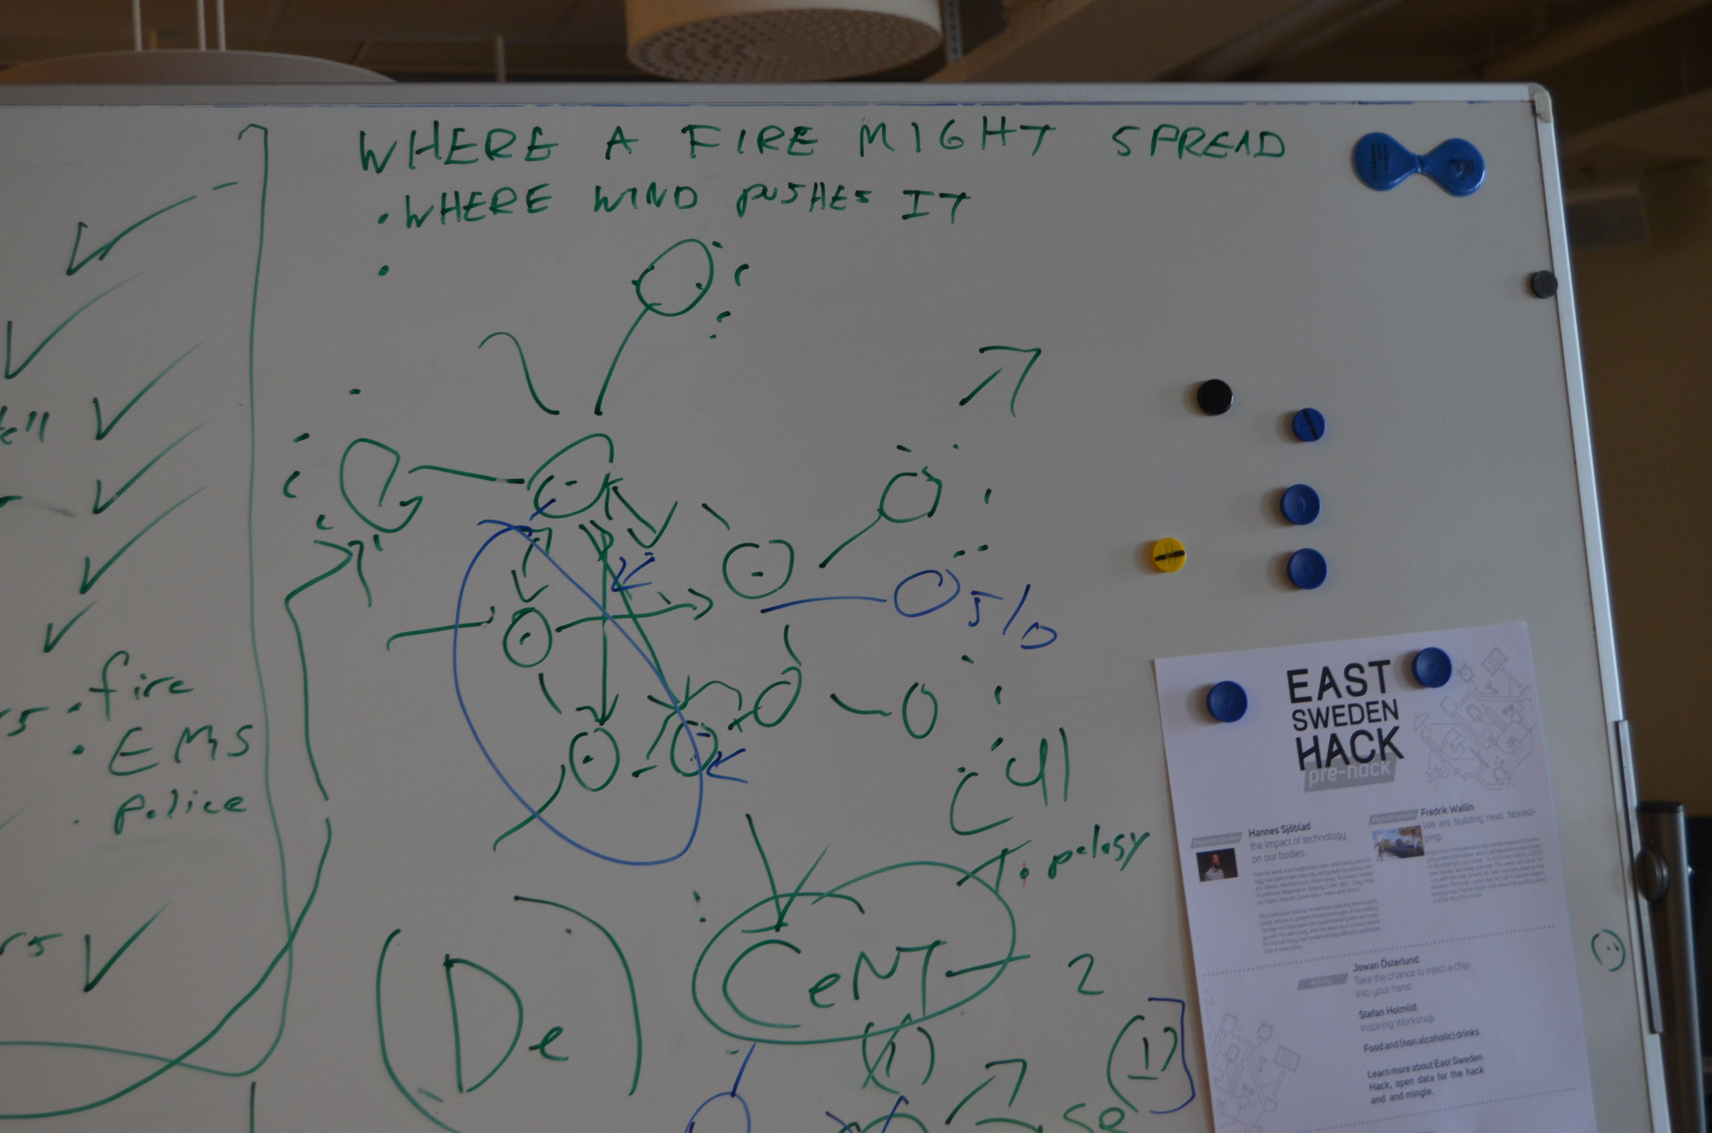
saveOS

Slide 8
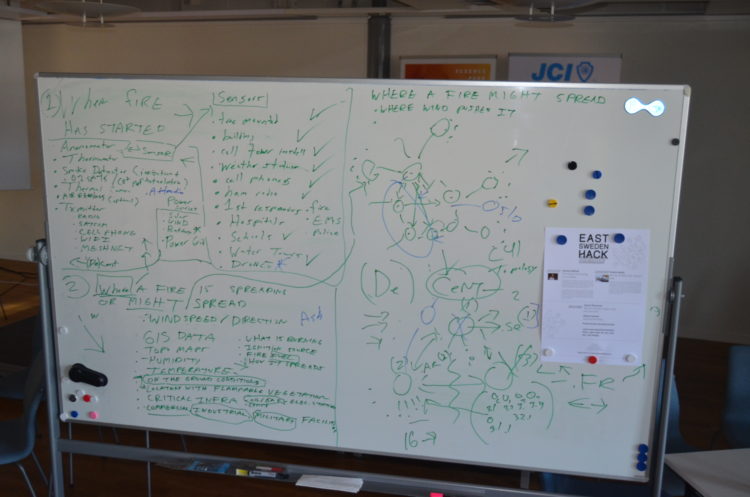
saveOS

Slide 9
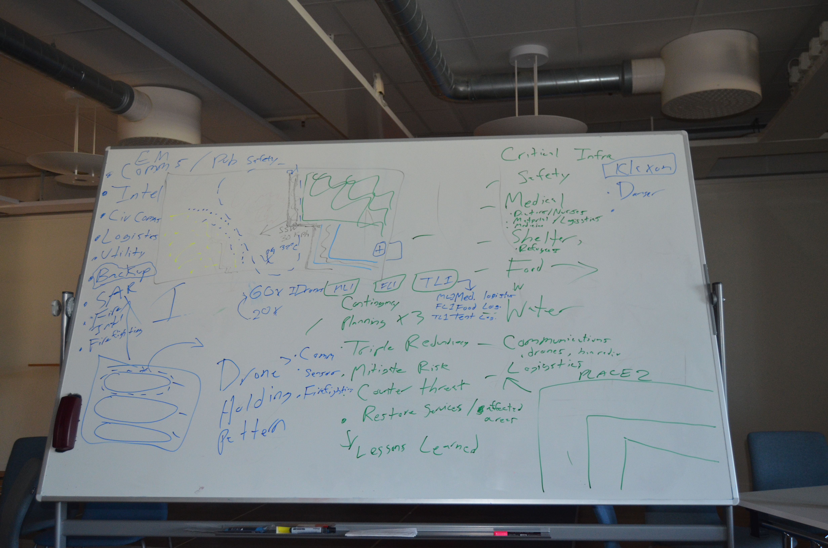
saveOS

Slide 10
saveOS
Add text here

